Slide 1
MEDIA KIT
2020
<YOUR COMPANY NAME HERE>

Slide 2
Engage Premium Audience
Target Taxi and Limousine audience who pays a premium over regular transport fares, through their 20 minutes ride across the city

Slide 3
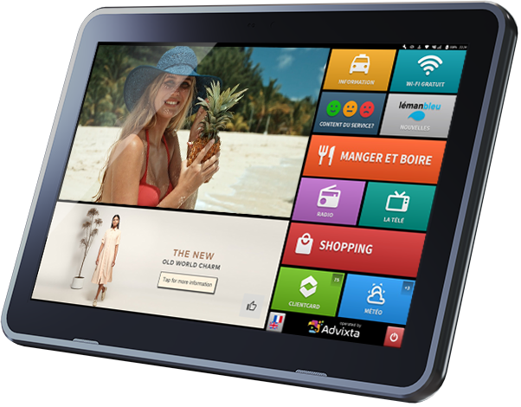
The Best in-car Entertainment & Advertising
The best in class, created for two reasons - to entertain passengers and deliver your message. Versatile and powerful to deliver multi-format media to audience with high-quality tailor made content.

Slide 4
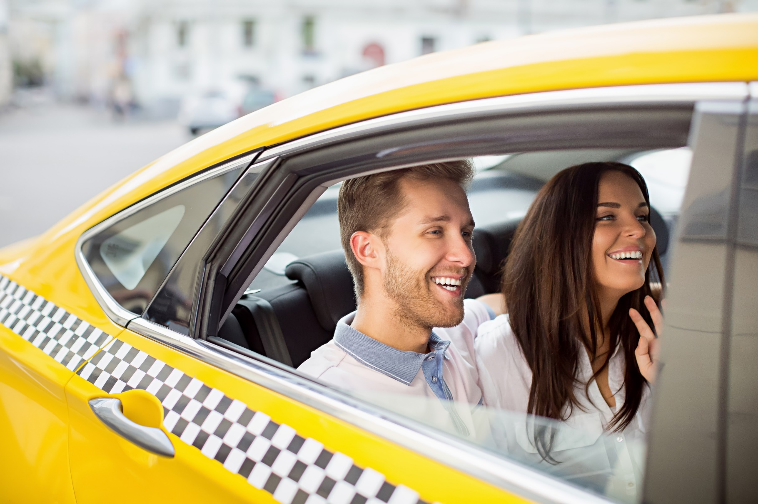
Right Time Right Place
50 millions daily users of ride-hailing services spend about in average 20 minutes sitting idle in backseat.
We simply use this opportunity to entertain and deliver interesting and relevant advertising to match useful with pleasant.

Slide 5
Why to Advertise In-Ride?
An opportunity to strengthen awareness and commitment over a longer period than any other channel.
Billboards: 2 Seconds
Printed ads: 15 Seconds
Digital Signage: 30 Seconds
In-ride: 15-20 minutes

Slide 6
Expose your brand in a unique environment
CAPTIVE AUDIENCE
NOT CLUTTERED
MEASURABLE
Passengers spend average of 20 minutes in taxis being idle. Perfect timing to deliver advertisers’ message.
Quite and private space helps to keep focus on ads. 97% of passengers touch at least one of the advertisements.
Advertisers get detailed viewer count and playback report. QR code helps to track advertisers’ page links.
INNOVATIVE
HIGH RECALL RATE
HIGH VALUE
Interactive and dynamic advertising attracts audience to engage with campaigns. 98.5% of passengers do not mind watching ads.
Taxi commercial recall rate is 40% – 50% vs average TV commercial recall rate of only 8% – 12%.
Naturally segregated upper middle class audience. Ads are not skipped or missed like in other media channels.

Slide 7
Run Your Targeted Ads
Geo-Fencing
Set radius around GPS location to target the audience in set circle.
Destination
Display ads relevant to the destination of the passenger
Impression
Limit impressions per trip, per day or per month and spread evenly.

Slide 8
Advixta Delivers
 | Advixta | OTT/CTV | TV | Radio | Mobile | Internet | OOH
Sight
Sound
Motion
Unskippable
Interactive
Guaranteed Impressions
Proximity to Purchase
Reach a desirable audience in an uncluttered media environment:
• Captive audience with extended dwell time
• Taxi Media loop doesn’t run unless there’s a rider
• Guaranteed Ad Plays, Guaranteed Impressions
• Interactive capabilities
• Geo-targeting, day-parting, week-parting

Slide 9
Customer Satisfaction Survey
Results of the survey from passengers who left their reviews directly on the screens.

Slide 10
Fleet – [Number of Cars]
Powerful analytics with real-time monitoring delivers seamless feedback report with detailed impressions, viewability and user interactions.
[enter number] screens
[enter number] video impressions
[enter number] banner impressions
[enter number] hours spent in taxi
[enter number] trips performed

Slide 11
Demographics
Clients are predominantly from ABC1 demographics
High Income Locals
Business People
Tourists
Taxis and ride-hailing cars are peculiar places where it is possible to reach special audience with more buying power. In general 90% of taxi users are willing to pay for comfort, open for new discoveries and value time spent in commuting.
Best shoppers, willing to pay for attraction and entertainment
Higher buying power, value their time and willing to pay for comfort

Slide 12
Passenger Engagement
The report results has proved the high efficiency of the media.
98
%
82
%
4.07%
Of the passengers did not switch off the screen.
Satisfaction rate according to integrated Smiley Survey
Average CTR (Clickthrough Rate) for advertising content.

Slide 13
User Interaction
The interaction measured by means of taps on links of the advertising.
26%
22%
20%
12%
10%
WEB LINKS
Links to the landing page of the advertising campaign or website of the advertising brand.
MAP LINKS
Clicks on map links to open map and see navigation to advertiser’s location
10%
LIKES
Users put like on advertisement for follow up and measuring. Not shared in Facebook.
FACEBOOK
Clicks on Facebook links of the advertising brands.
INSTAGRAM
Clicks on Instagram links of the advertising brands.
PHONE LINKS
Phone number of the advertiser in form of QR code for convenience.

Slide 14
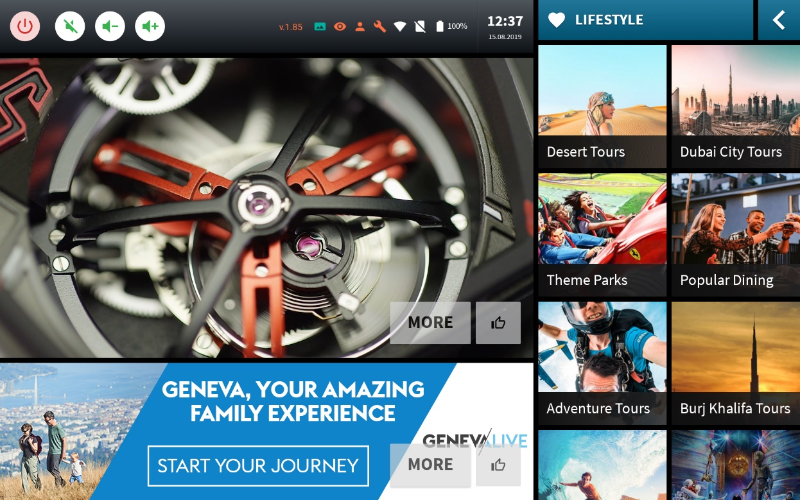
Inventory
Offers, Brands and Products
Highly effective way to announce special campaigns, sale and offers. Possible to rent dedicated category or brand.
Video Advertisement
High resolution eye catching video ads are good for building strong brand recognition. The most effective advertising in the system.
Banner Advertisement
Image banners can be used for branding and campaigns messages. Very effective especially when used in combination with video.

Slide 15
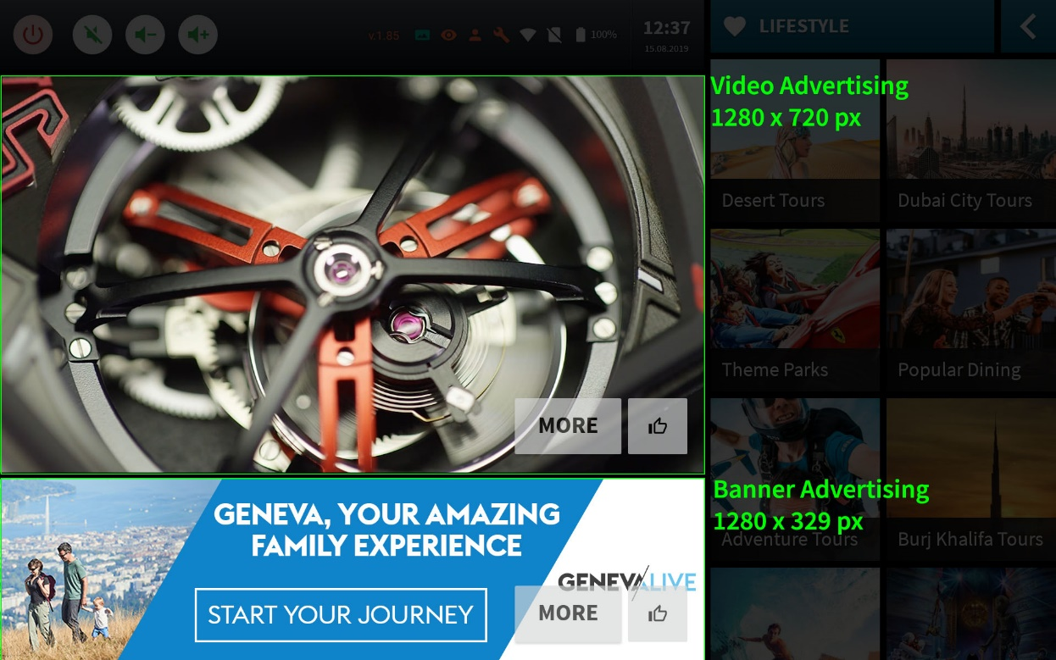
Media Specs
Video
1280 x 720 pixels resolution, MP4 format, 20 to 30 seconds.
Banner
1280 x 329 pixels resolution, JPEG/PNG format, 10 to 15 seconds.
Click Through Page
Alternative to landing page, additional information about campaign can be show on click in following format:
Product description in HTML text
Images JPEG format
Telephone number with digits and “+” symbol.
Full address compatible with Google Maps
HTTP Website address or any special Website pages address prepared for the campaign
Facebook & Instagram pages if available

Slide 16
Pricing
CAMPAIGN EXAMPLE 1
CAMPAIGN EXAMPLE 2
1 month / [ENTER NUMBER] screens
Guaranteed [ENTER NUMBER] views
3 months / [ENTER NUMBER] screens
Guaranteed [ENTER NUMBER] views + 20% discount
Media | Monthly | Per View
Video 30 seconds | [PRICE] | [CPM]
Banner 15 seconds | [PRICE] | [CPM]
Button Categories | [PRICE] | [CPM]
Media | Monthly | Per View
Video 30 seconds | [PRICE] | [CPM]
Banner 15 seconds | [PRICE] | [CPM]
Button Categories | [PRICE] | [CPM]
Note: Price can be either fixed per day/week/month or per thousand views/clicks. Estimated number of views is calculation by multiplying average number of trips by average duration of trips in minutes per screen and number of screens then dividing to number of views per minute. On the other hand, CPM (cost per mille/thousand) is limited to certain number. When number is reached the campaign stops. Buyer’s with limited budgets generally chose CPM price. Therefore, in generally fixed price shall be cheaper than CPM.

Slide 17
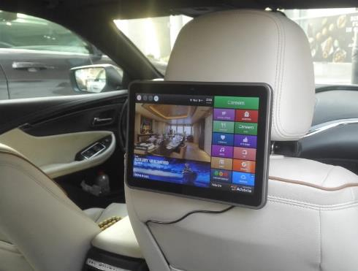
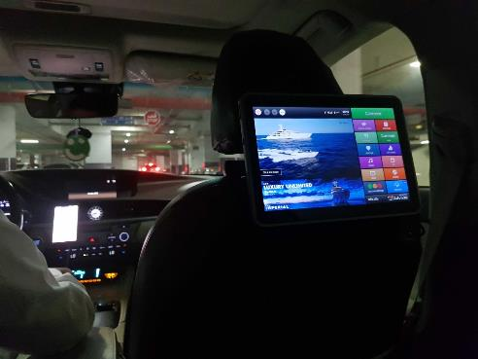
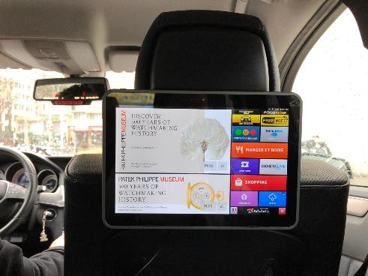
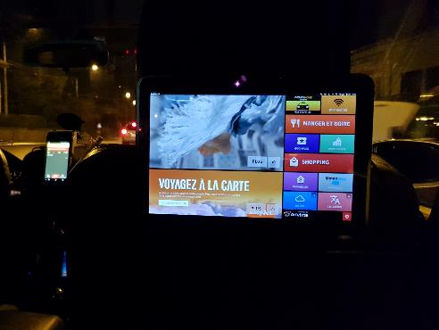
Showcase
We are proud and delighted to receive photos shot by passengers with gratitude and appreciation.

Slide 18
Our Clients
[PUT LOGOS OF YOUR CLIENTS]

Slide 19
Thank You
Name Surname
Position
Telephone
E-mail

